Slide 1
LIF 101 lecture 7 or 13 18th March, 2016
Problems from DNA as a genetic material and Genetic code

Slide 2
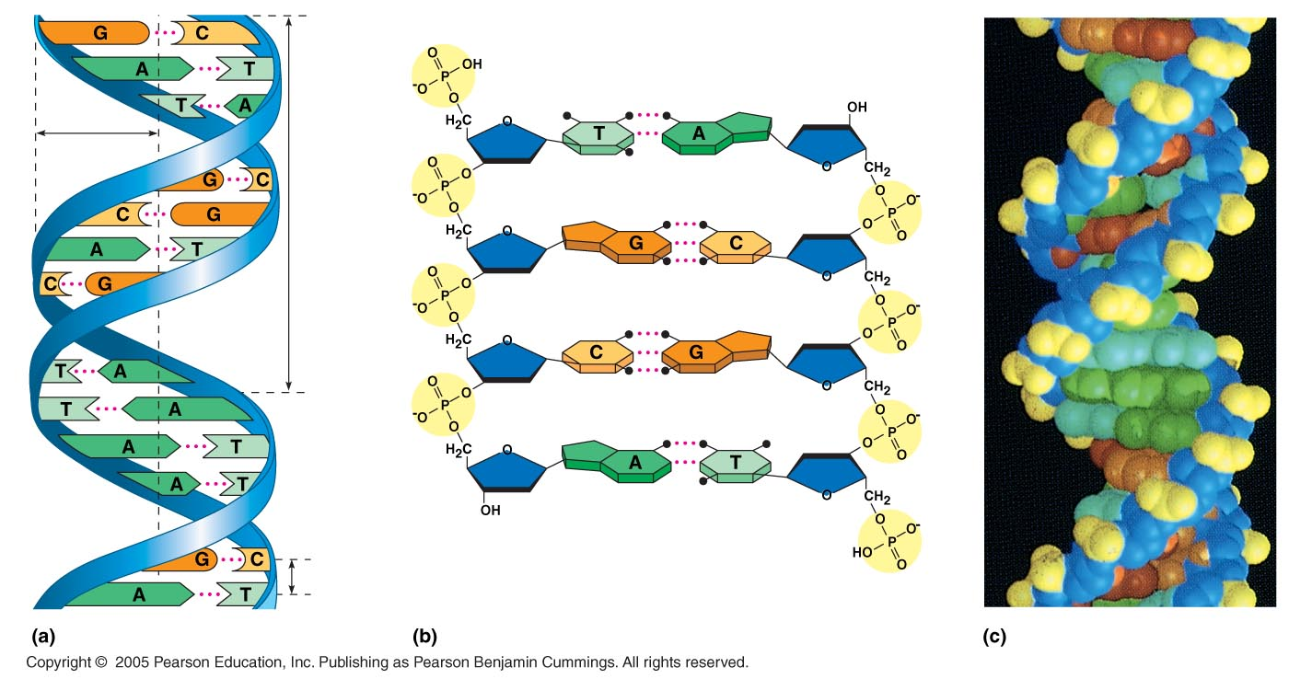
The Basic Principle: Base Pairing to a Template Strand
The relationship between structure and function is manifest in the double helix
Since the two strands of DNA are complementary each strand acts as a template for building a new strand in replication
In DNA replication, the parent molecule unwinds, and two new daughter strands are built based on base-pairing rules
5′ end
Hydrogen bond
3′ end
1 nm
3.4 nm
3′ end
0.34 nm
5′ end

Slide 3
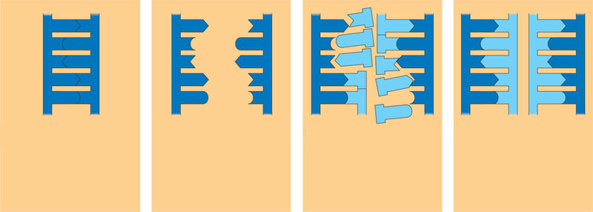
DNA replication
The parent molecule unwinds, and two new daughter strands are built based on base-pairing rules
A
T
A
T
A
T
A
T
A
T
A
T
C
G
C
G
C
G
C
G
C
G
C
G
T
A
T
A
T
A
T
A
T
A
T
A
A
T
A
T
A
T
A
T
A
T
A
T
G
C
G
C
G
C
C
G
C
G
C
G
(a) The parent molecule has two
complementary strands of DNA.
Each base is paired by hydrogen
bonding with its specific partner,
A with T and G with C.
(b) The first step in replication is
separation of the two DNA
strands.
(c) Each parental strand now
serves as a template that
determines the order of
nucleotides along a new,
complementary strand.
(d) The nucleotides are connected
to form the sugar-phosphate
backbones of the new strands.
Each “daughter” DNA
molecule consists of one parental
strand and one new strand.

Slide 4
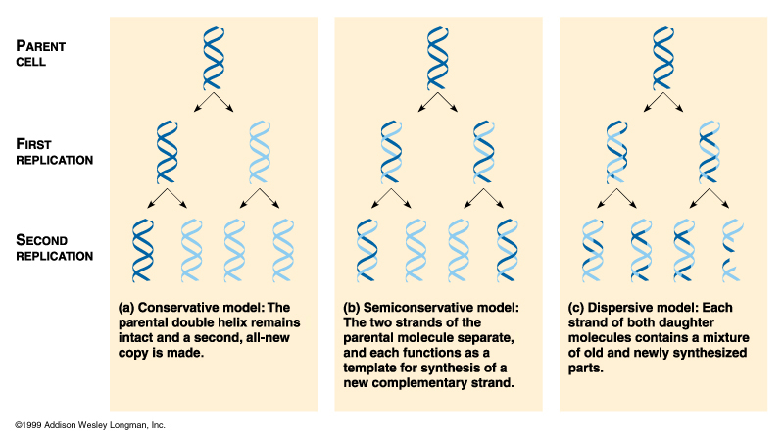
DNA Replication
DNA must replicate during each cell division
3 alternative models for DNA replication were hypothesized:
  Semiconservative replication
  Conservative replication
  Dispersive replication
Semi-conservative
Conservative
Dispersive

Slide 5
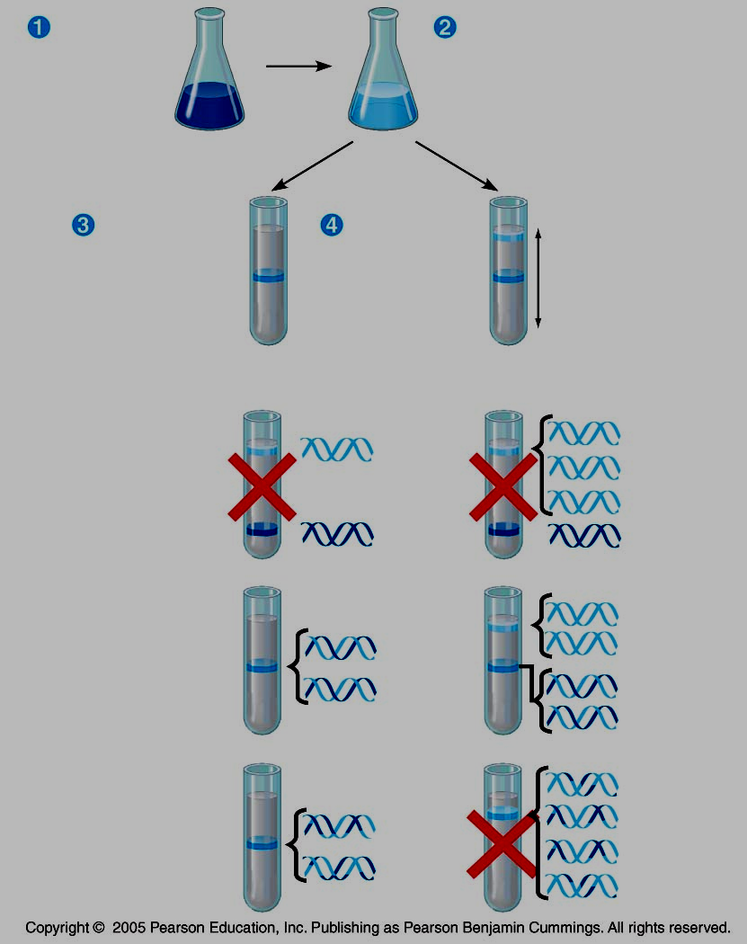
Meselson-Stahl Experiments
Labeled the nucleotides of old strands with a heavy isotope of nitrogen (¹⁵N), new nucleotides were indicated by a lighter isotope (¹⁴N).
The first replication in the 1⁴N medium produced a band of hybrid (¹⁵N-¹⁴N) DNA, eliminating the conservative model.
A second replication produced both light and hybrid DNA, eliminating the dispersive model and supporting the semi-conservative model.
Bacteria
cultured in
medium
containing
¹⁵N
Bacteria
transferred to
medium
containing
¹⁴N
DNA sample
centrifuged
after 20 min
(after first
replication)
DNA sample
centrifuged
after 40 min
(after second
replication)
Less
dense
More
dense
First replication
Second replication
Conservative
model
Semiconservative
model
Dispersive
model

Slide 6
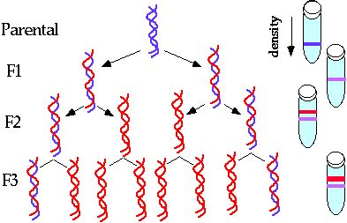
Why there are two bands?
Why this band is thicker

Slide 7
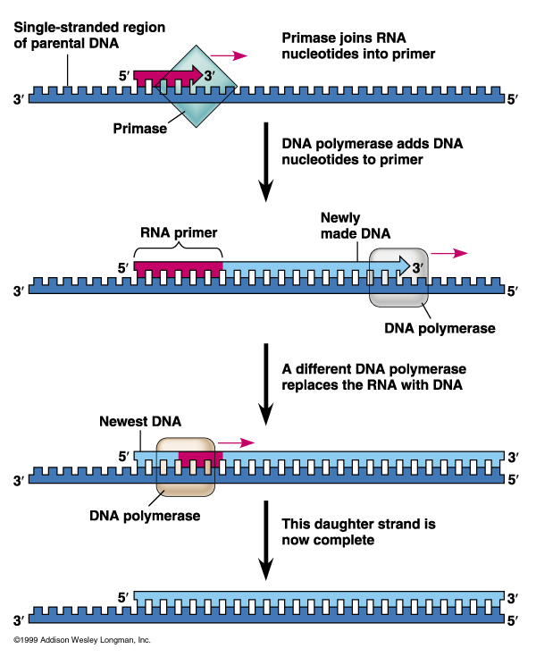
Mechanism of DNA Replication
DNA replication is catalyzed by DNA polymerase III which needs an RNA primer
DNA polymerase III cannot initiate the synthesis of a polynucleotide, they can only add nucleotides to the 3′ end
The initial nucleotide strand is an RNA primer
RNA primase synthesizes primer on DNA strand
DNA polymerase adds nucleotides to the 3’ end of the growing strand
DNA polymerase III adds nucleotides to primer
DNA polymerase I degrades the RNA primer and replaces it with DNA
What could be the consequence if you take a drug that inhibits primase?

Slide 8
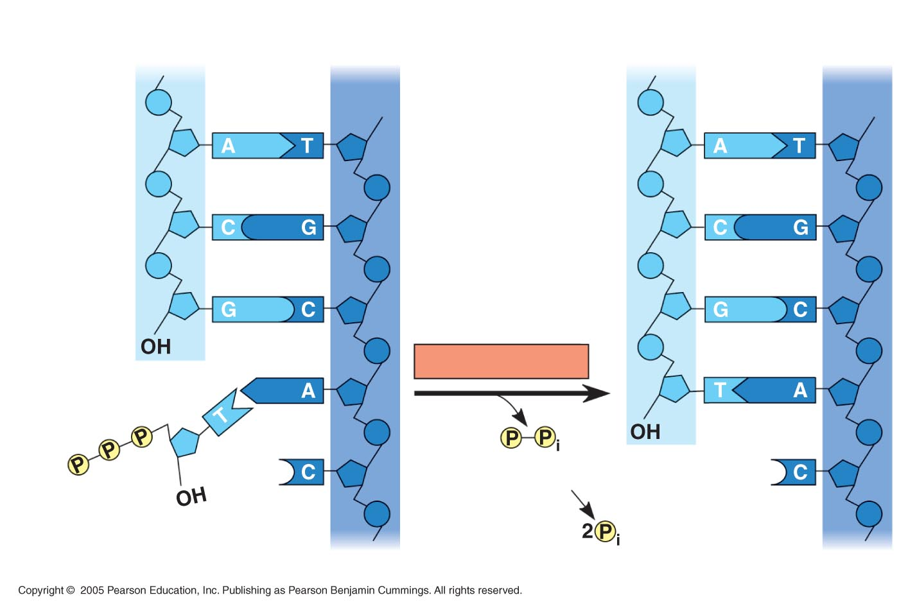
Mechanism of DNA Replication
Nucleotides are added by complementary base pairing with the template strand
DNA always reads from 5’ end to 3’ end for transcription replication
During replication, new nucleotides are added to the free 3’ hydroxyl on the growing strand
The nucleotides (deoxyribonucleoside triphosphates) are hydrolyzed as added, releasing energy for DNA synthesis.
The rate of elongation is about 500 nucleotides per second in bacteria and 50 per second in human cells
New strand
Template strand
5′ end
3′ end
5′ end
3′ end
Sugar
Phosphate
Base
DNA polymerase
3′ end
Pyrophosphate
3′ end
Nucleoside triphosphate
5′ end
5′ end

Slide 9
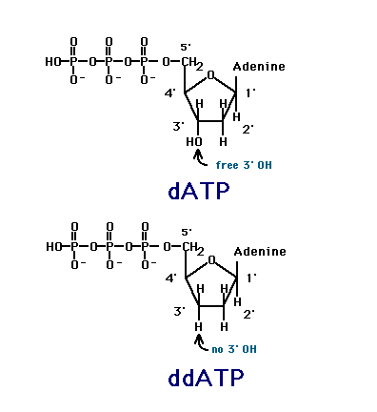
What if, in a reaction mixture (DNA template Plus dATP, dCTP, dGTP, dTTP plus DNA polymerase) where DNA synthesis is going on, one adds certain amount of ddTTP

Slide 10
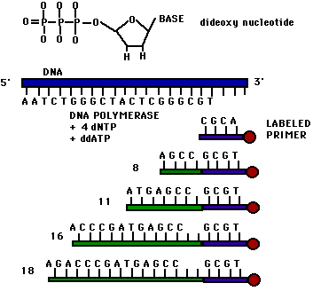
What do you need to do if you were to find the rest of the sequence

Slide 11
